Slide 1
Basketball Management
Team TDP’s
CPSC-431 Spring 2018
Thomas Ngo, Danh Pham, & Peter Vu

Slide 2
Purpose & Initial Requirements
Our website provides the functionality to completely manage a basketball league
Using our website, you can keep track of all
Teams
Players
Games
Statistics
User Authentication
Role-based Access
3-tier Software Solution
Presentation Layer (client)
Application Layer (HTML and PHP)
Database Layer (SQL)
Maintaining User Sessions

Slide 3
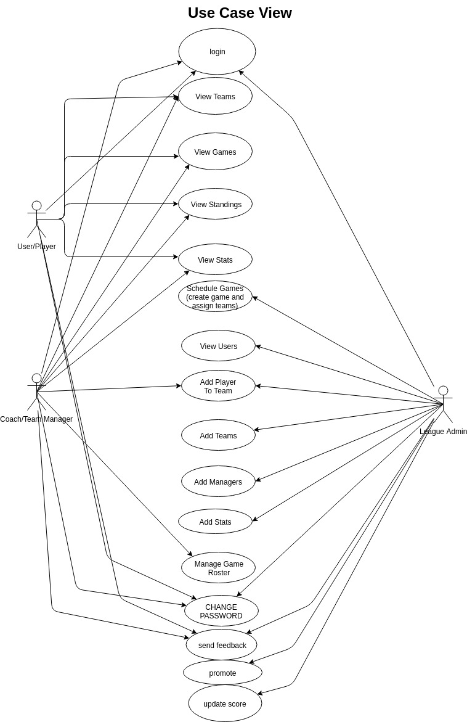
Use Case View
Notes:
Thomas: For the use case view, we have 3 main roles/actors. The left side includes normal or player user and manager user who use the web application. On the right side, league admin user have the ability to manage/control the web application. In the middle, there are use cases which represent for the answers that we try to solve for the user’s specification and requirement. Actually, before we came up with this use case view, we set up some of the questions that users ask for in our web application. For example, one of the question is what teams are in the league. So, in order to answer this question, we have a view team use case which is only available for left side actors. On the other hand, other question is what is the score in each game. Update score use case is available for admin to modify the score for each game.

Slide 4
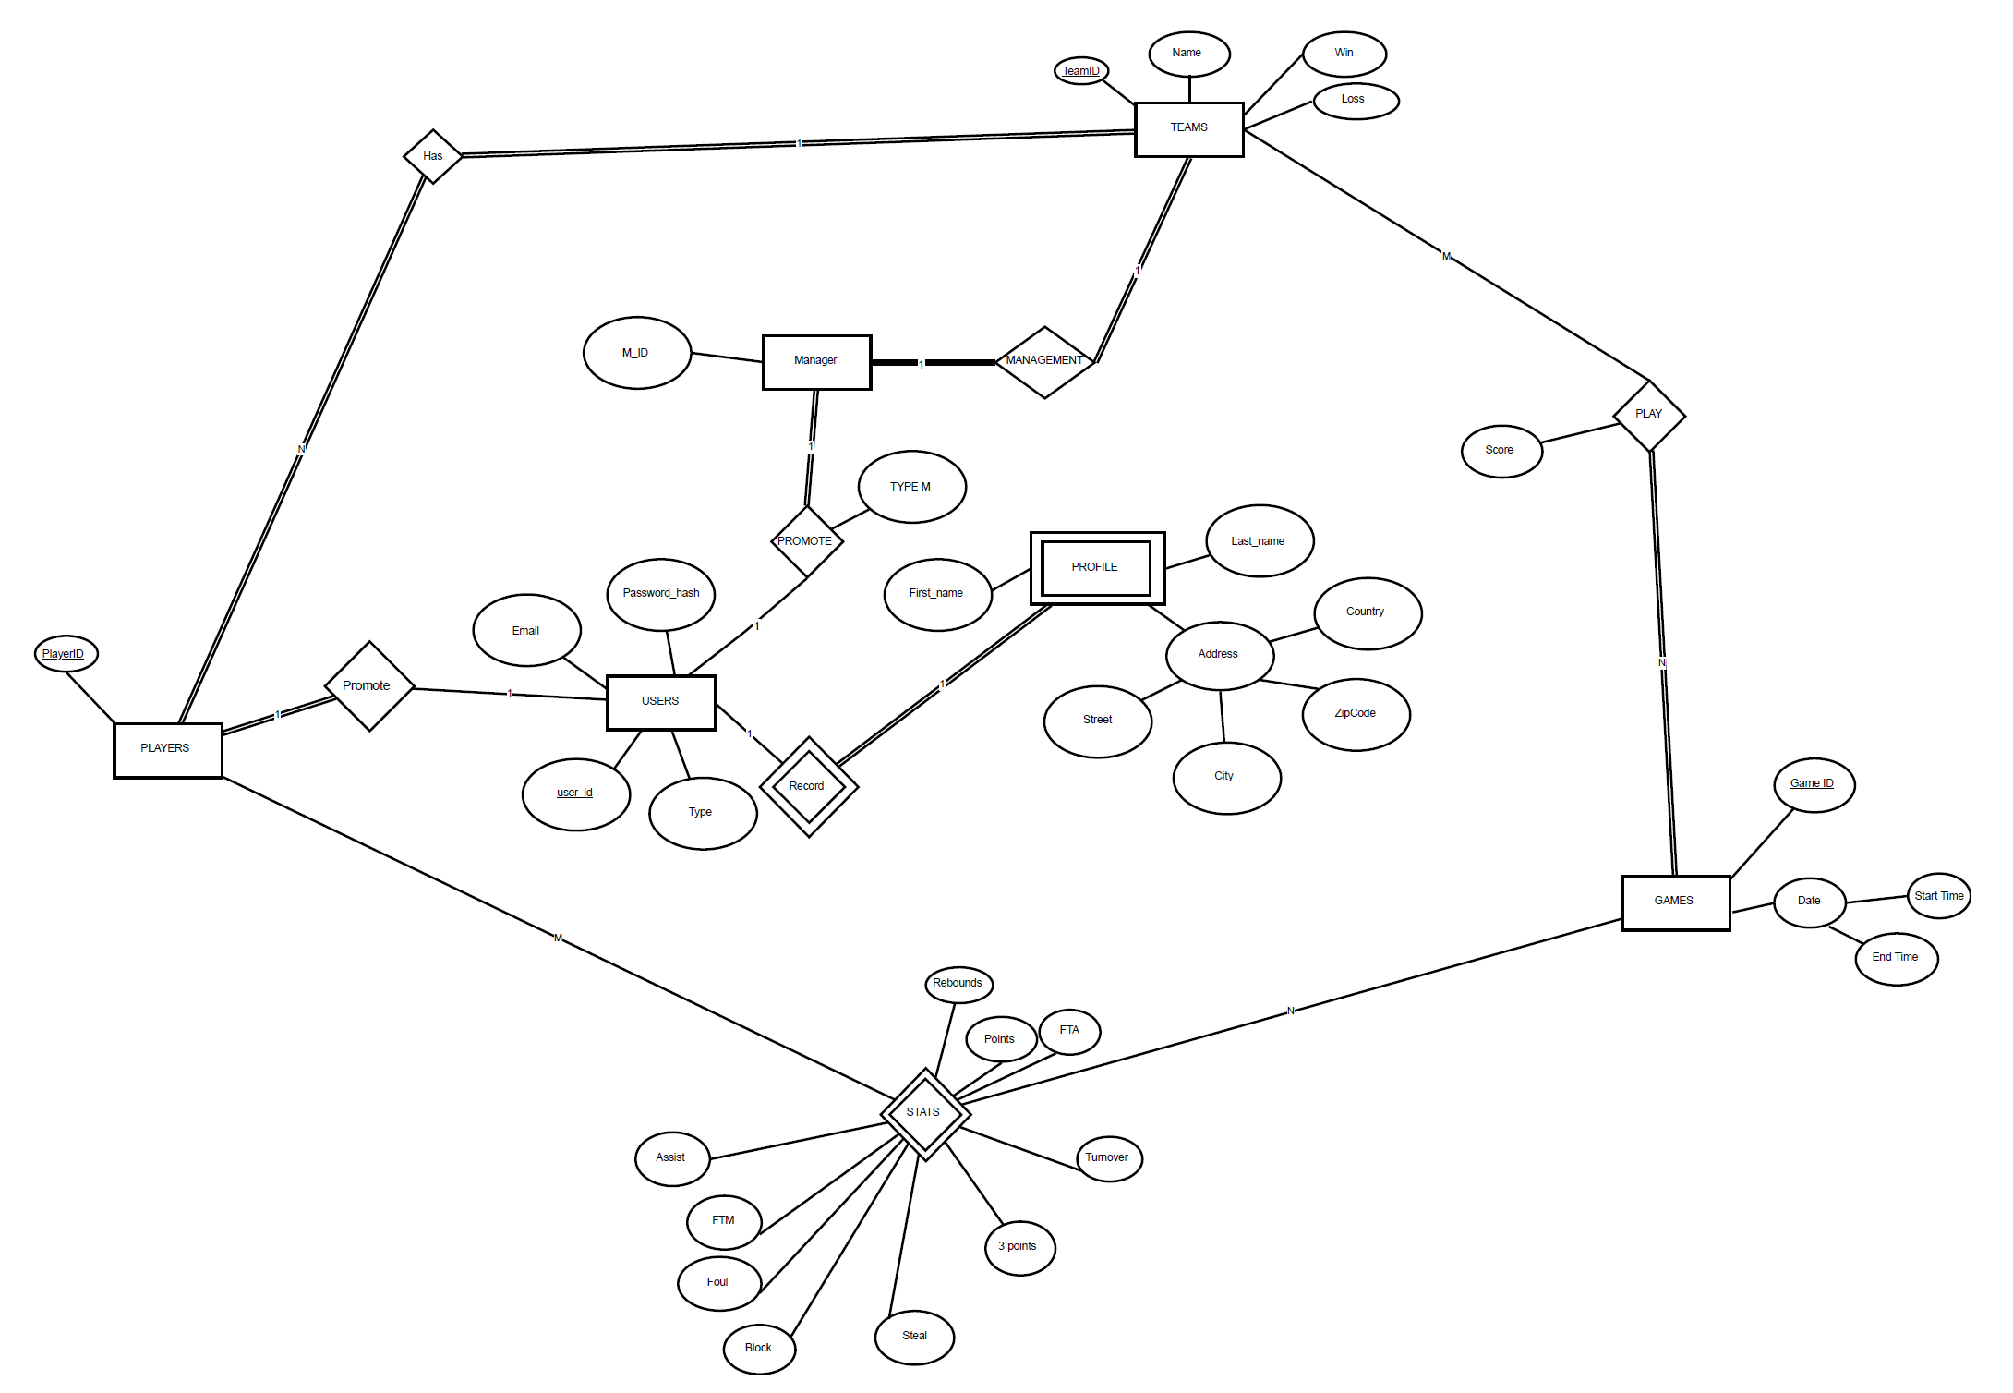
Entity Relationship View

Slide 5
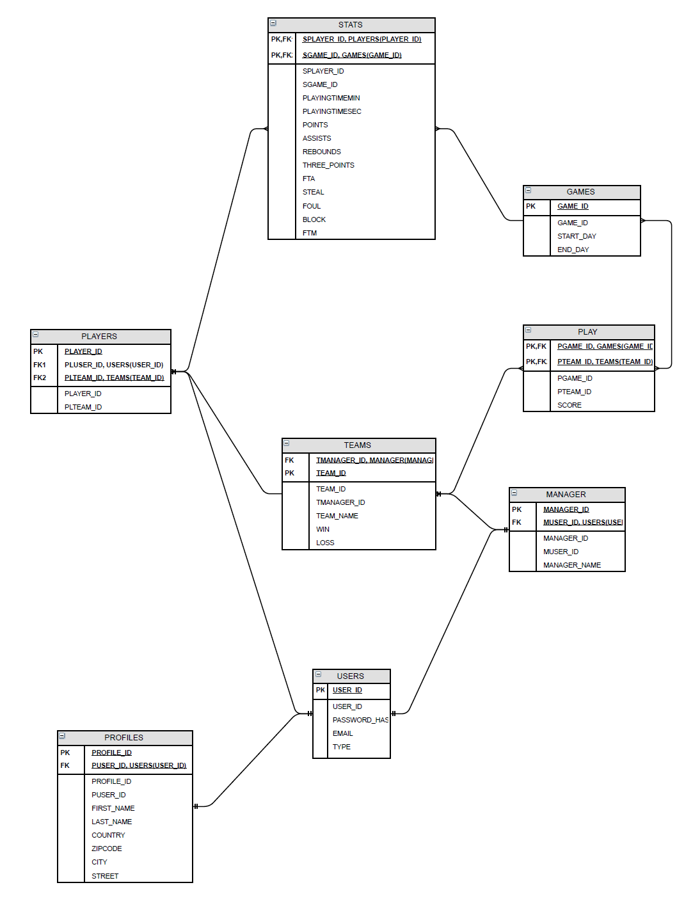
Entity Relationship View

Slide 6
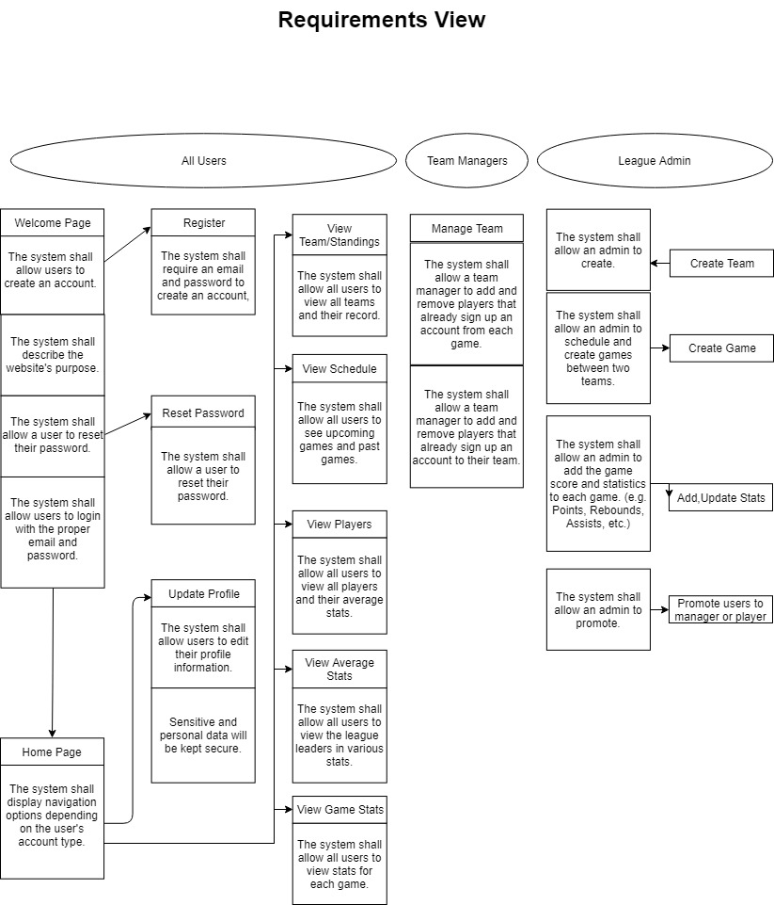

Slide 7
Requirements View
Passwords must be at least 6 characters long.
Each team can have only one manager.
Team manager can add player as only in the list of Account role Player.
Manger can remove/add players to specific game.
Admin can changes role of accounts.

Slide 8
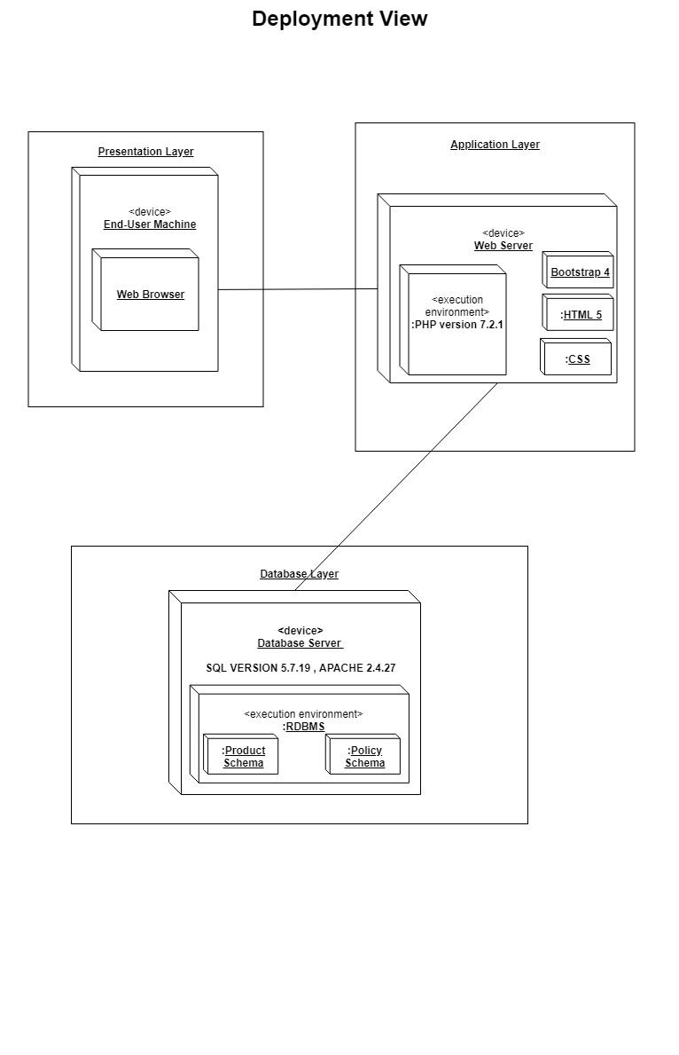
Deployment View

Slide 9
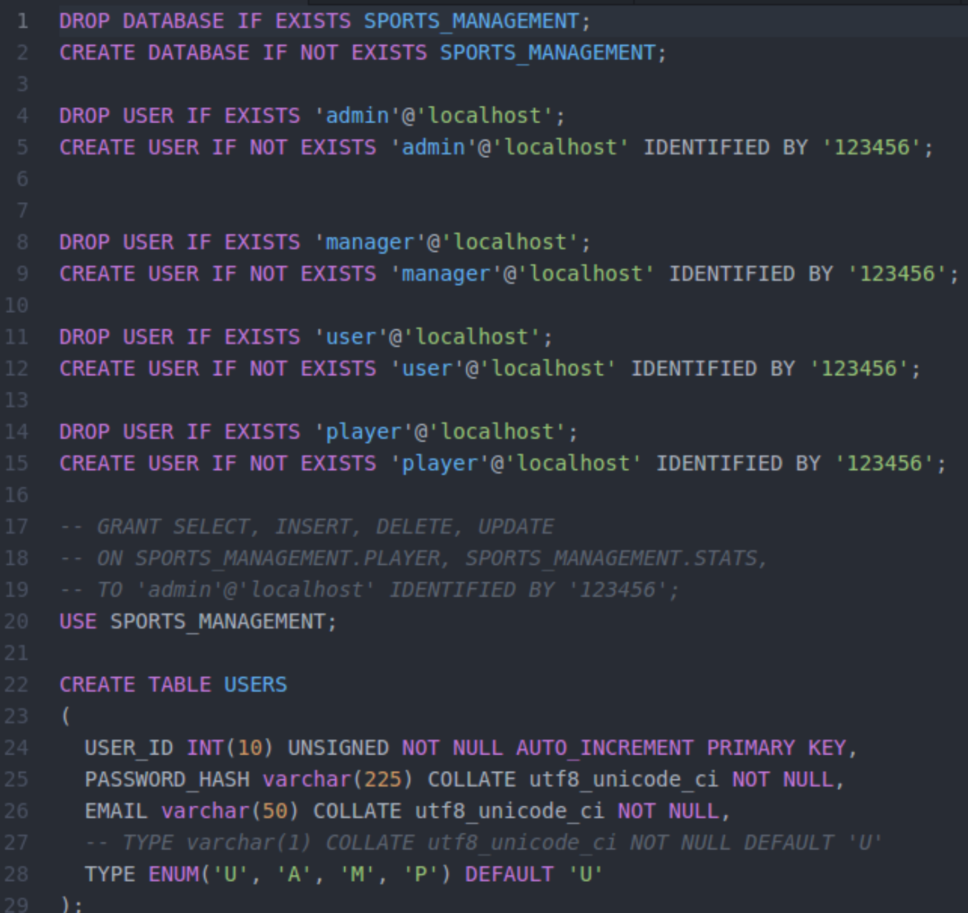
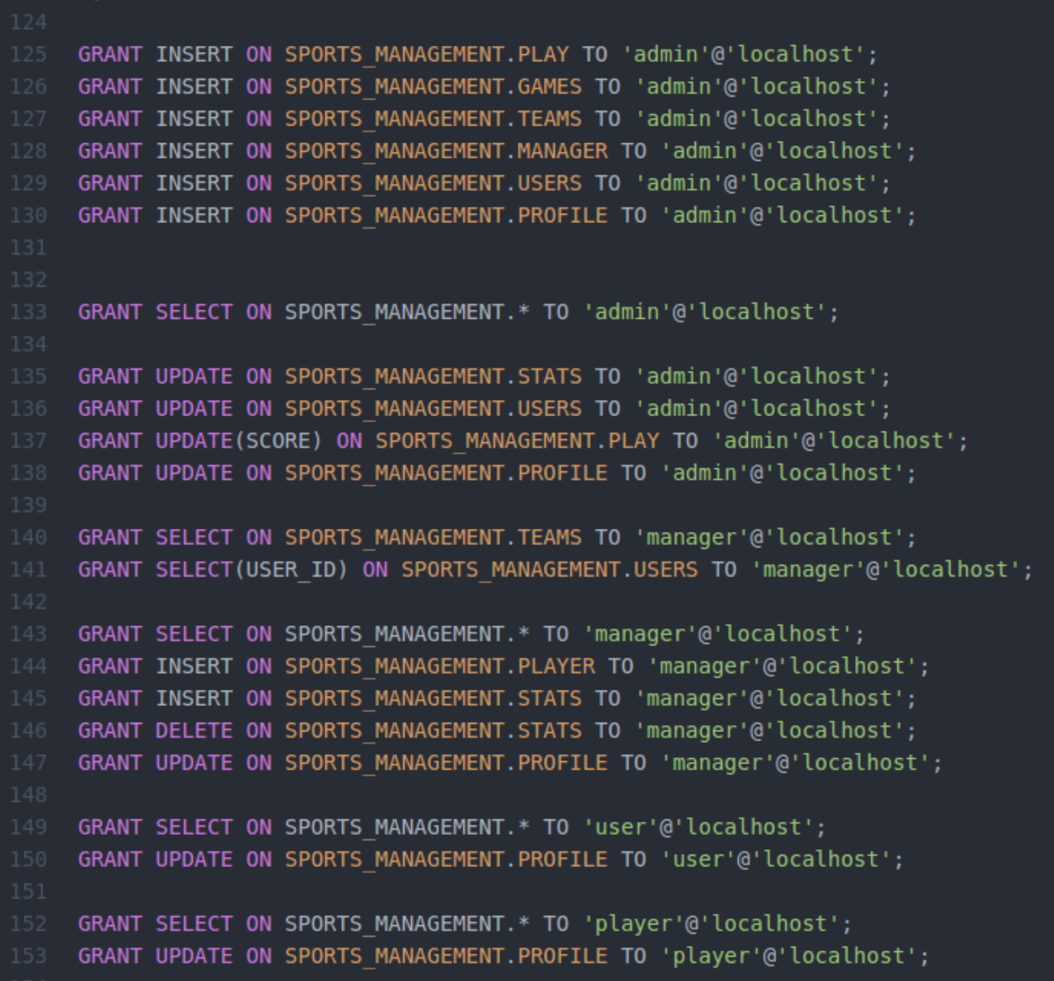
Implementation View
Notes:
Danh:
4 ROLE BASES
TYPE FOR WEB API
GRANT PRIVI
DEMO
REGISTER ( ONLY TYPE U ) , LOGIN , FORGOT PASS, PHP MAILER , LOGIN TO EACH PAGES

Slide 10
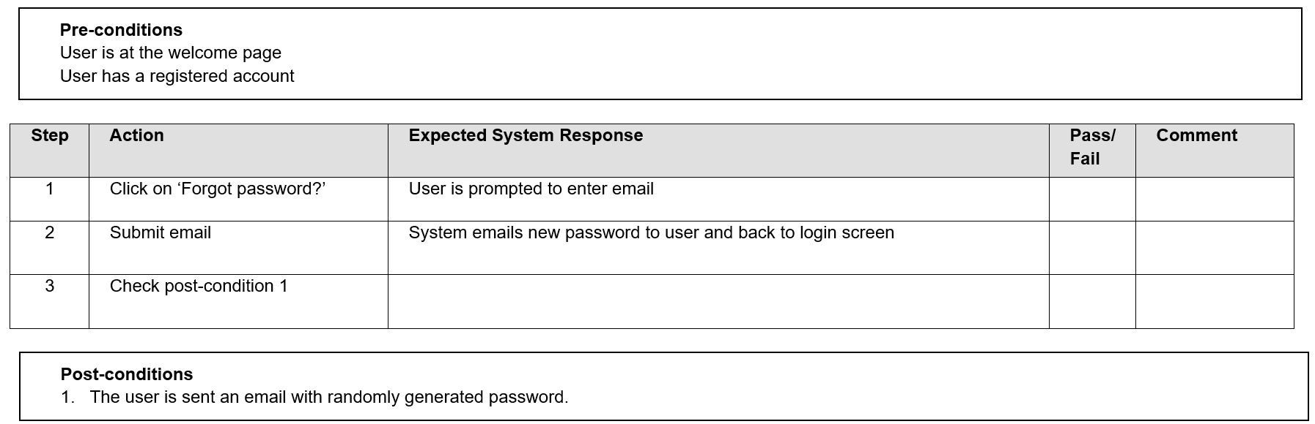
Testing View
Test Case #1: Reset Password
Notes:
Peter:

Slide 11
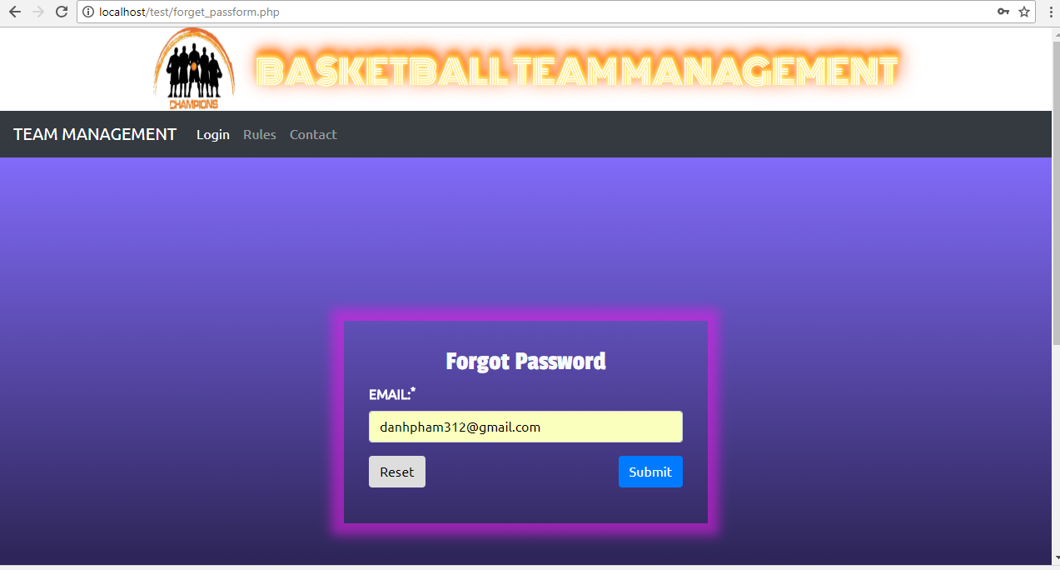

Slide 12
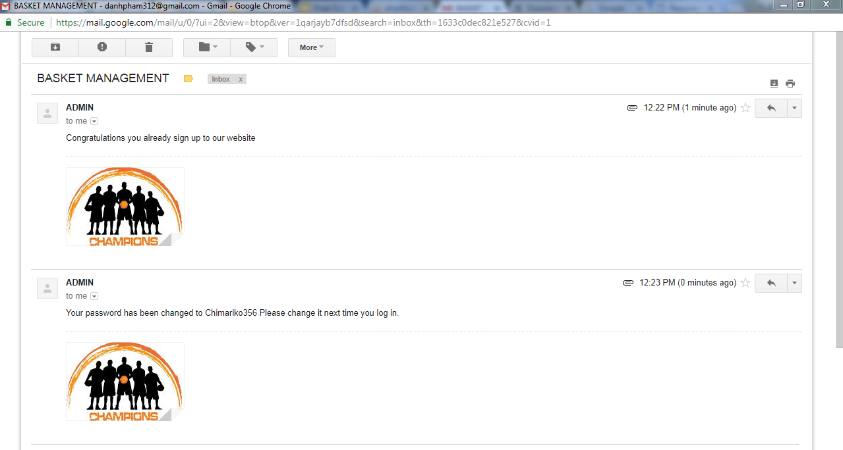

Slide 13
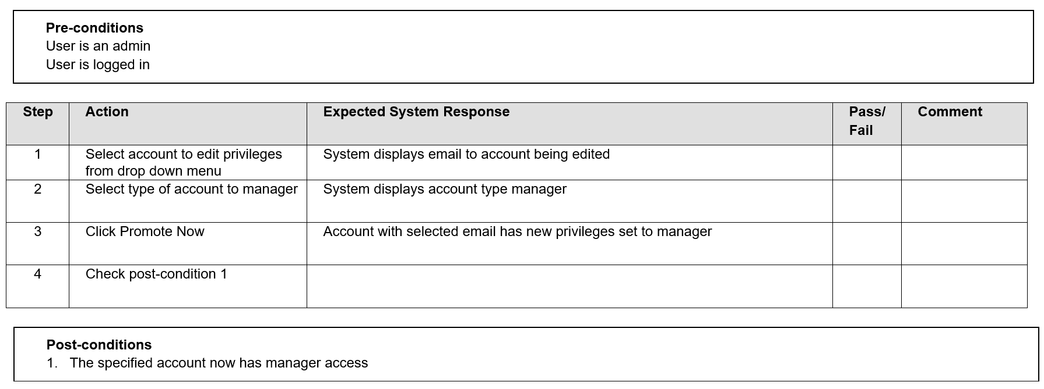
Testing View
Test Case #2: Promote User to Manager
Notes:
Peter:

Slide 14
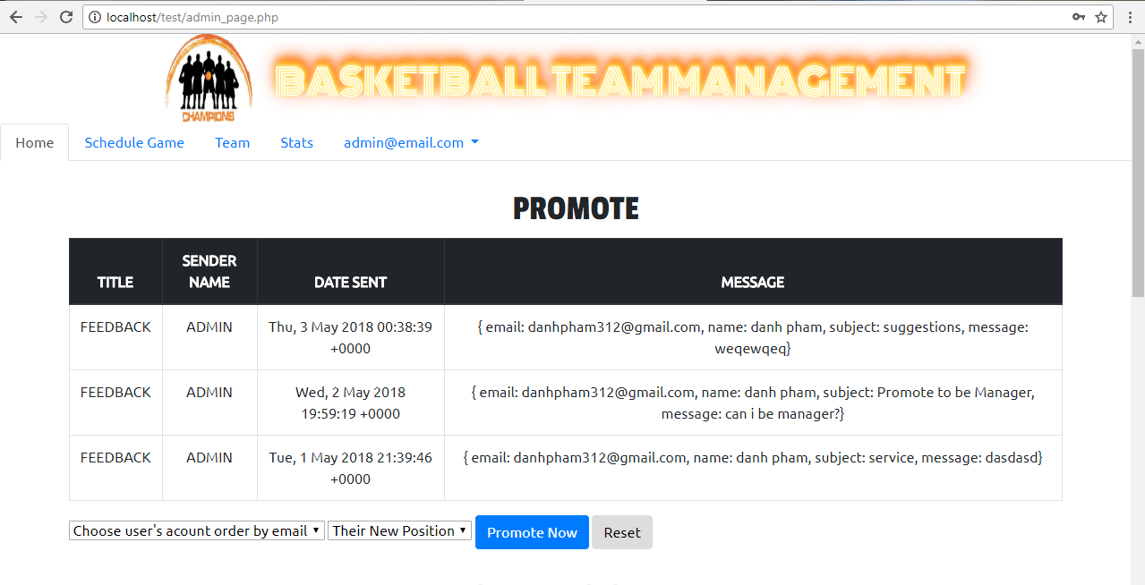

Slide 15
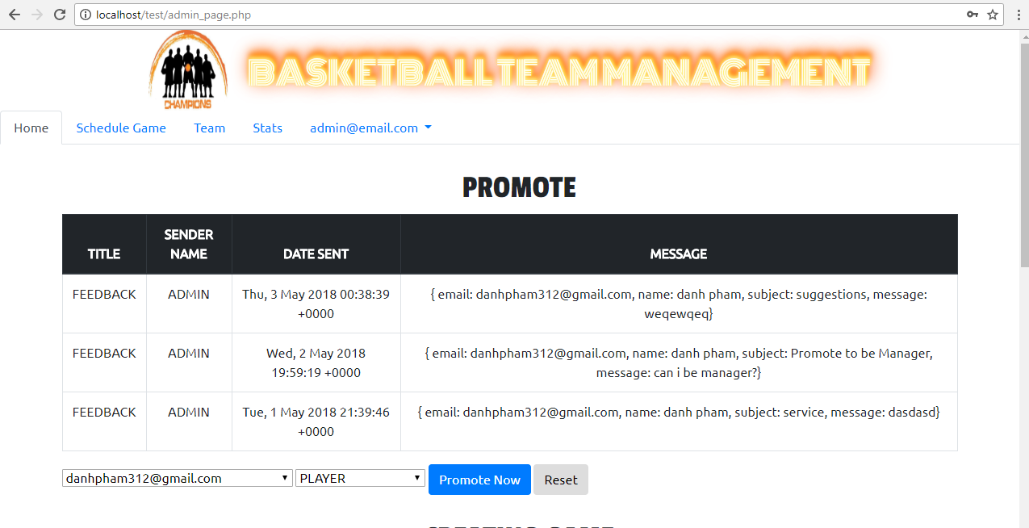

Slide 16
